Slide 1
Magnetism
MS864M

Slide 2
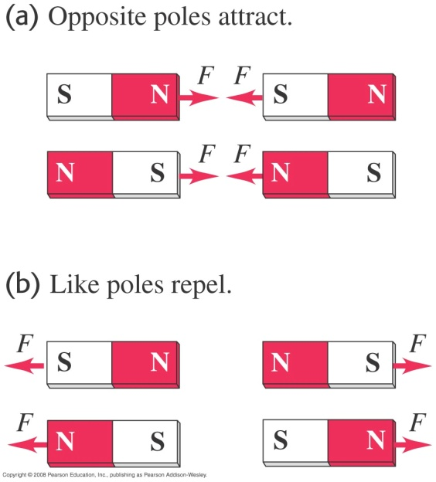
Magnetism
Magnetic phenomena were first observed more than 2500 years ago in Turkey.
If a bar-shaped magnet is free to rotate, one end points north and is called the north seeking pole (N) and the other end is the south seeking pole (S).
Like poles repel and unlike poles attract.

Slide 3
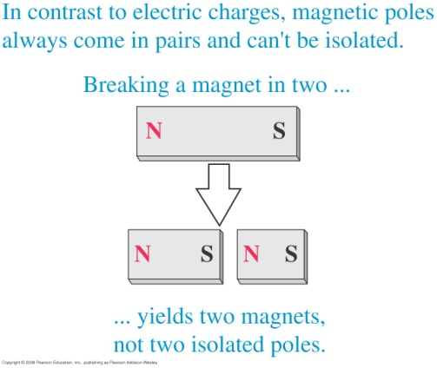
Magnetic poles always come in pairs
If a bar magnet is broken into two parts, each broken end becomes a pole.

Slide 4
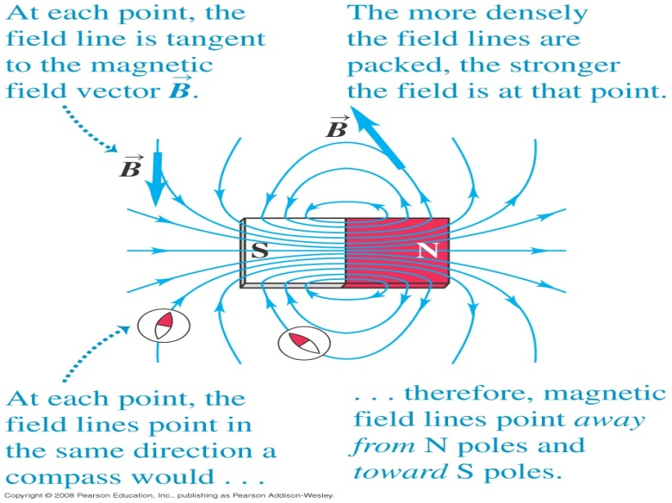
Magnetic field
A magnetic field is a region where a magnetic pole or a moving electric charge experiences a magnetic force.
The magnetic field B at a given point is tangent to the field line at that point.

Slide 5
Magnetic forces on moving charges
From experiments it has been found that the magnetic force on a moving charge is F = q(v × B).
The magnitude of F is q|v||B|sin(ϕ) where ϕ is the angle between v and B.
The direction of F is perpendicular to both v and B.
The SI unit of B is N A⁻¹ m⁻¹ or tesla (T).

Slide 6
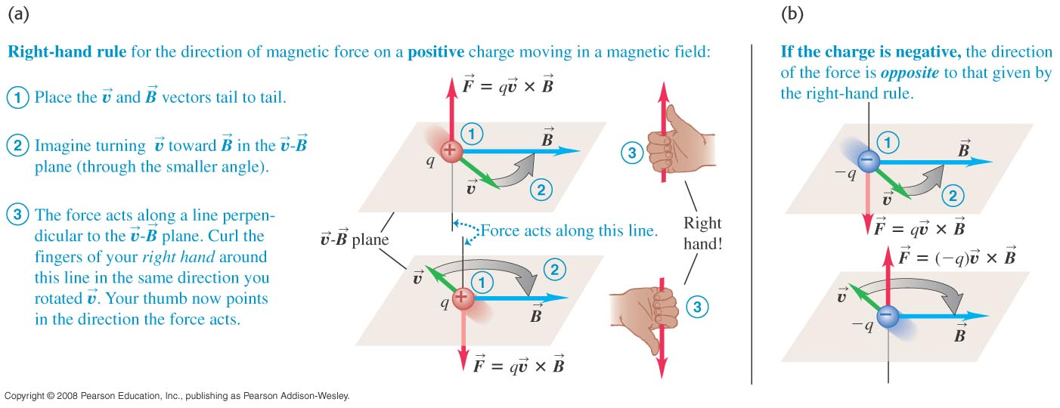
Right-hand grip rule to find the direction of force
Grip the velocity vector and move towards the magnetic field vector.
The thumb gives the direction of the magnetic force on a positive charge.
If the charge is negative the force is opposite to the one given by the thumb.

Slide 7
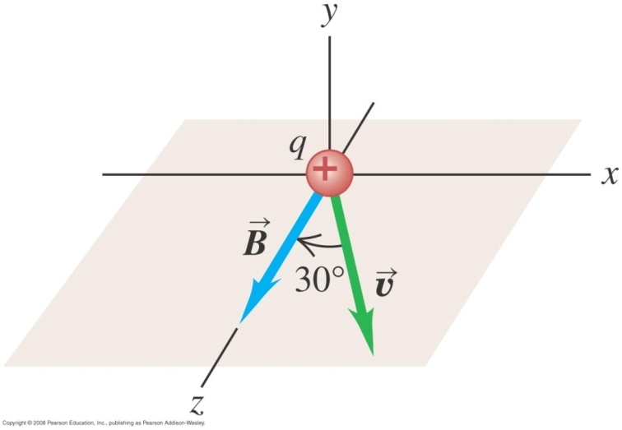
Example 1
A beam of protons moves at 3.0 x 10⁵ m/s through a uniform magnetic field with a magnitude 2.0 T. The magnetic field is directed along the positive z-axis as shown in the below figure. The velocity of each proton lies in the x-z plane at an angle of 30º to the positive z-axis. Find the force on a proton. Charge of a proton is 1.60 x 10⁻¹⁹ C.
Notes:
F = (−4.8 × 10⁻¹⁴ N) j

Slide 8
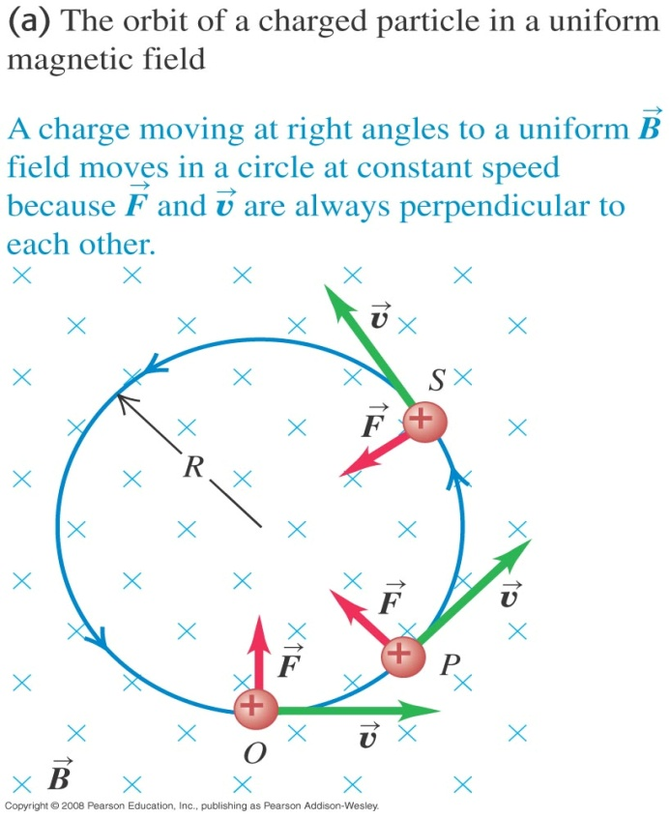
Charge moving perpendicular to uniform B field
The magnetic force is always perpendicular to the velocity and the particle moves with constant speed in a circle. Animation
For motion in a circle
The angular speed is

Slide 9
Cyclotron frequency
The frequency known as cyclotron frequency is
Note that f does not depend on R.
The period is

Slide 10
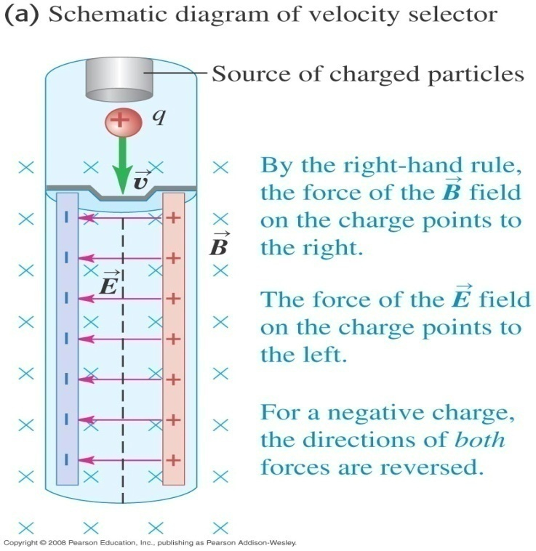
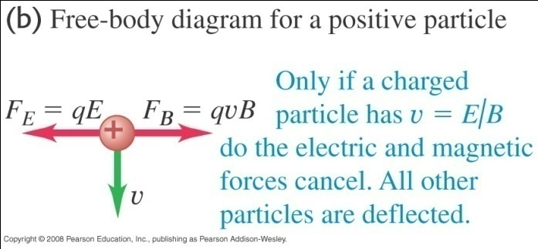
Velocity selector
Velocity selector is used to select positive and negative charges having a particular speed.
E and B are perpendicular to each other and are such that the net force on the charged particle is zero. i.e.

Slide 11
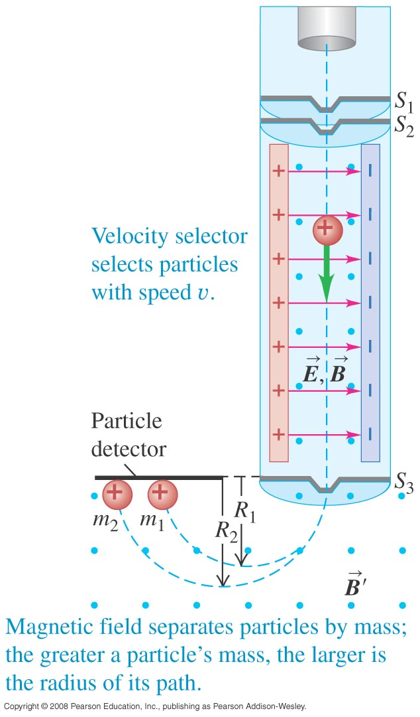
Mass spectrometer
In a mass spectrometer, singly charged positive ions with velocity v = E/B pass through S₃.
These ions then move into a region with a different magnetic field B’ that is perpendicular to the page.
They move in circular arcs with radius R = mv/qB’.
Isotopes of the same element (with different m) will move with different radii.

Slide 12
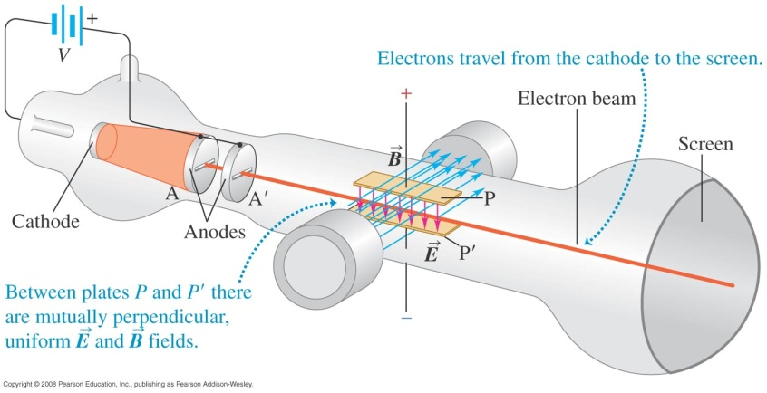
Thomson’s e/m experiment
Electrons in a glass container are accelerated by a p.d. V between anodes A and A’ and enter a magnetic field.
The work done by the electric field on the electrons is eV, where e is the electronic charge. The electrons gain kinetic energy.

Slide 13
Thomson’s e/m experiment - cont
From conservation of energy,
Only electrons whose magnetic force equals its electric force will pass through and strike the screen, i.e.

Slide 14
Thomson’s e/m experiment - cont
There is only a single value of e/m = 1.76 x 10¹¹ C kg⁻¹.
Since this value did not depend on the cathode material, the electrons in the beam is a common constituent of all matters.
After some years Millikan succeeded in measuring the charge of the electron.
Combining with Thomson’s result and Millikan’s experiments, the mass of the electron was determined to be about 9.11 x 10⁻³¹ kg.

Slide 15
Example 2
In a Thomson’s e/m experiment, the accelerating potential is 150 V with a deflecting electric field of magnitude 6.0 × 10⁶ N/C. Speed of light is 3 × 10⁸ m/s. Mass of the electron = 9.11 × 10⁻³¹ kg.
a) At what fraction of the speed of light do the electrons move?
b) What should be the magnetic field?
c) With this magnetic field, what will happen to the electron beam if the accelerating potential is increased above 150 V?
Notes:
0.024 times the speed of light
B = 0.83 T
c) Increasing potential V will increase the speed. The upward electric force does not change but the magnetic force will increase and the electron beam will turn downward and will hit the hit the tube below the undeflected position.

Slide 16
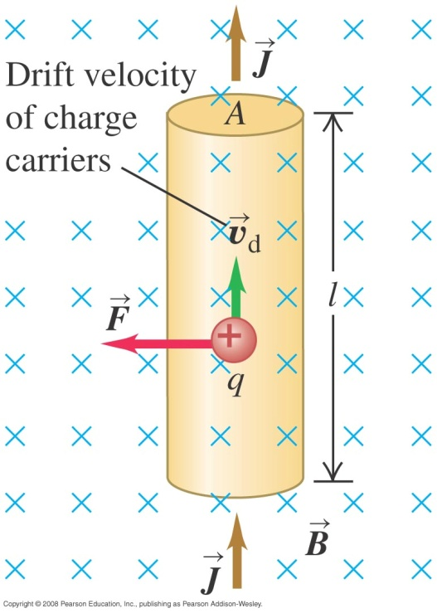
Magnetic force on a current-carrying conductor
Suppose positive charges flow with drift velocity v_{d} in a wire of length l and area A and perpendicular to a uniform field .
The total number of charges is nAl, where n = number of charges per unit volume.
The total force on all the charges is

Slide 17
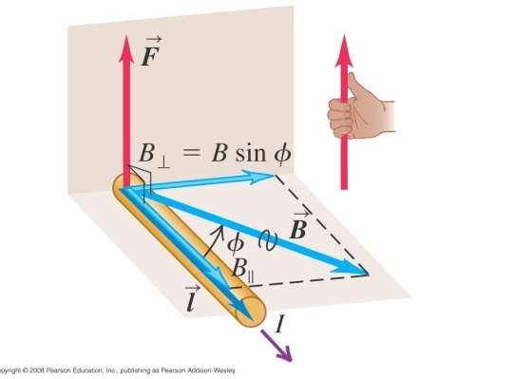
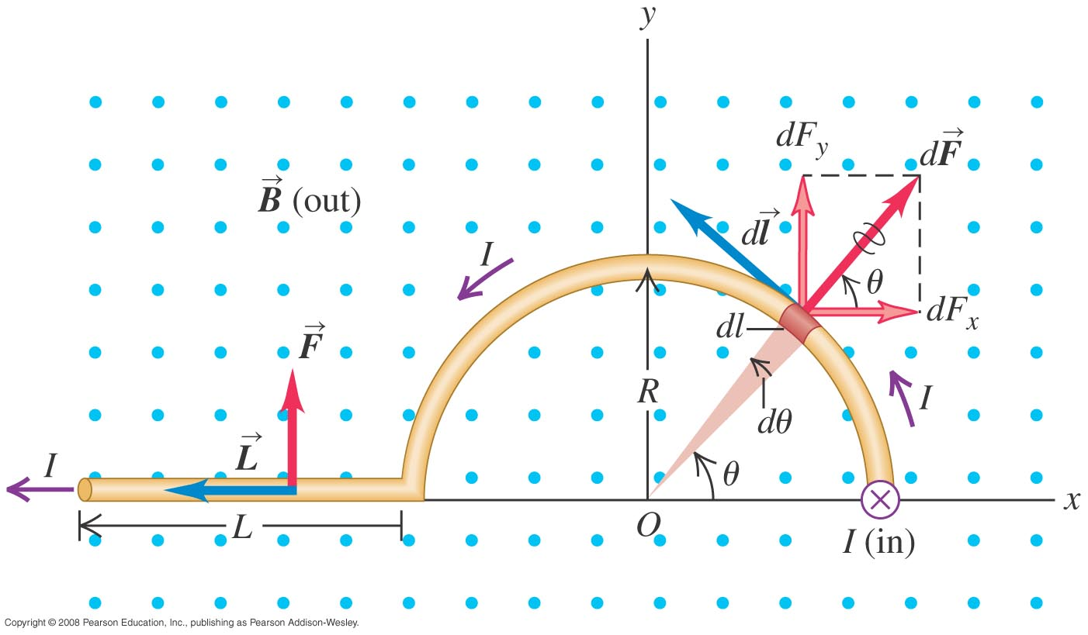
Magnetic force on a current-carrying conductor
If makes an angle φ with the conductor, the force becomes .
In vector form
If the conductor is not straight, the force on each segment is
The total force is obtained by integrating over the whole length of the conductor.

Slide 18
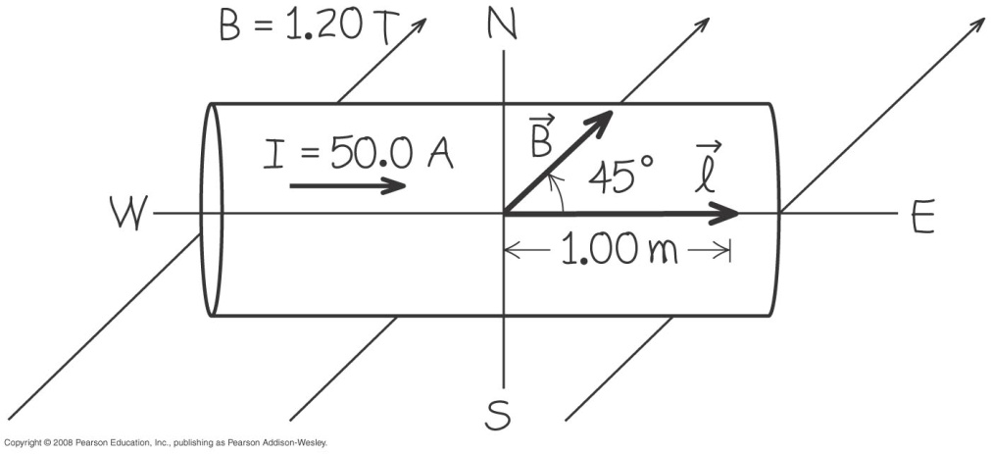
Example 3
A straight horizontal copper rod carries a current of 50.0 A from west to east in a region between the poles of a large electromagnet. In this region there is a horizontal magnetic field toward the north east (45º north of east) with magnitude 1.20 T.
a) Find the magnitude and direction of the force on a 1.00-m section of rod.
b) What should be done to the rod to maximize the magnitude of force?
c) What is the magnitude of the force in the above case in b)?
Notes:
F = 42.4 N in the +z direction (upward). F = (42.4 N) k
The angle between the l and B should be 90º. Rotate the rod clockwise by 45º from its orientation so that the current runs toward the south east.
c) F = 60.0 N

Slide 19
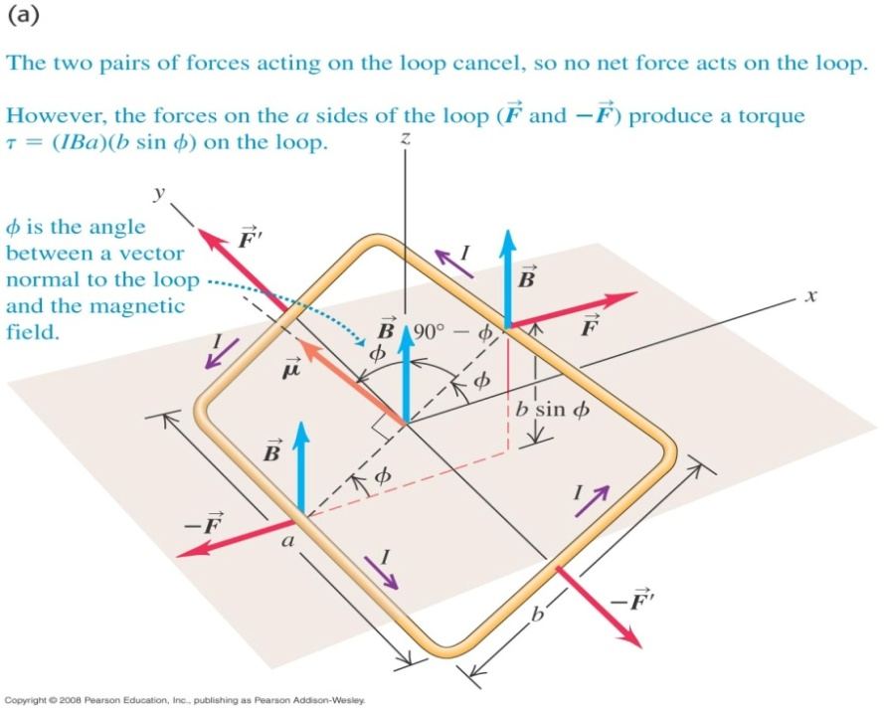
Rotational effect of force on a current loop
The length b makes an angle of (90º – φ) with .
have magnitude .
They act along the y-axis and produce no rotational effect.
have magnitude .
acts on the right length a in the +x-direction and acts on the left length a in the -x-direction.
Together they rotate the coil clockwise.

Slide 20
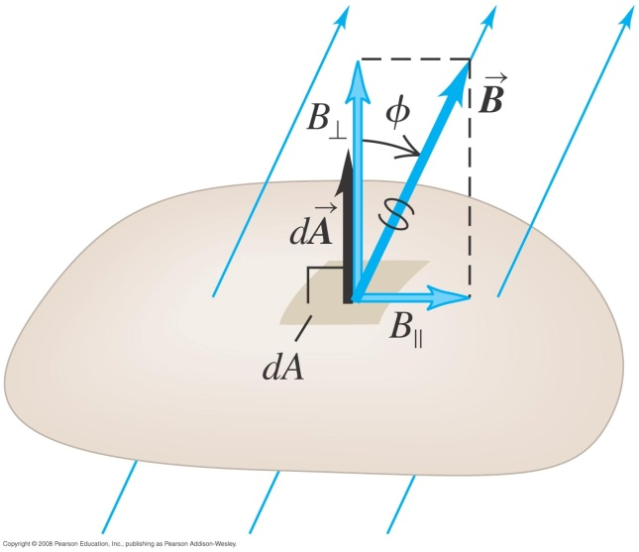
Magnetic flux
The magnetic flux passing through an area dA is given by
The total magnetic flux through a surface A is given by
The SI unit of magnetic flux is weber (Wb), where 1 Wb = 1 T m².
Hence B is also known as flux density.

Slide 21
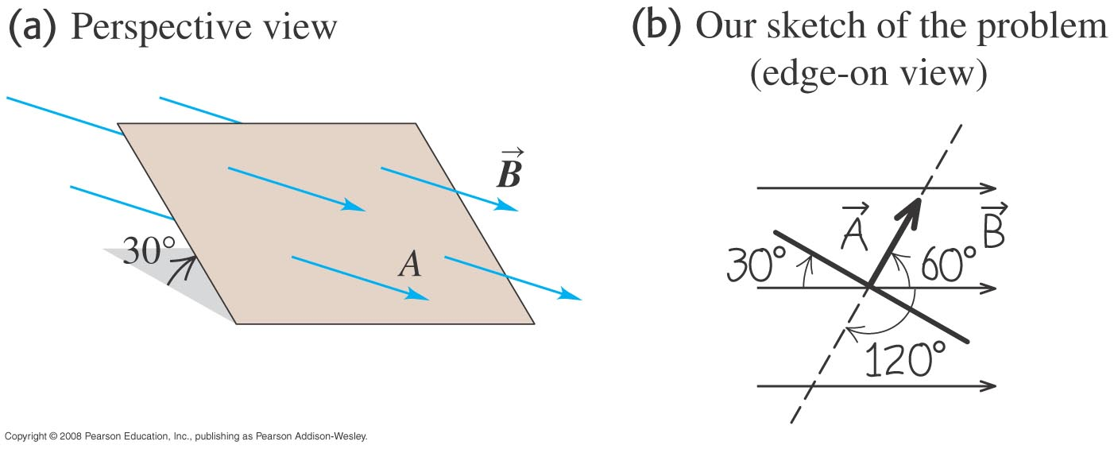
Example 5
The below figure shows a perspective view of a flat surface with area 3.0 cm² in a uniform magnetic field. If the magnetic flux through this area is 0.90 mWb, calculate the magnetic field and find the direction of the area vector.
Notes:
B = 6.0 T and Area is 60º to the magnetic field.

Slide 22
Self Learning

Slide 23
Gauss law of magnetism
Magnetic field lines always form closed loops.
Hence, every field line that enters the surface also exits from it.
Since there is no magnetic monopole, the total magnetic flux through a closed surface is always zero. This is the Gauss’s law of magnetism.
Mathematically it is written as

Slide 24
Torque on a current loop – vector approach
lie along different lines and give rise to a torque which points in the positive y direction.
By definition torque is,
Hence

Slide 25
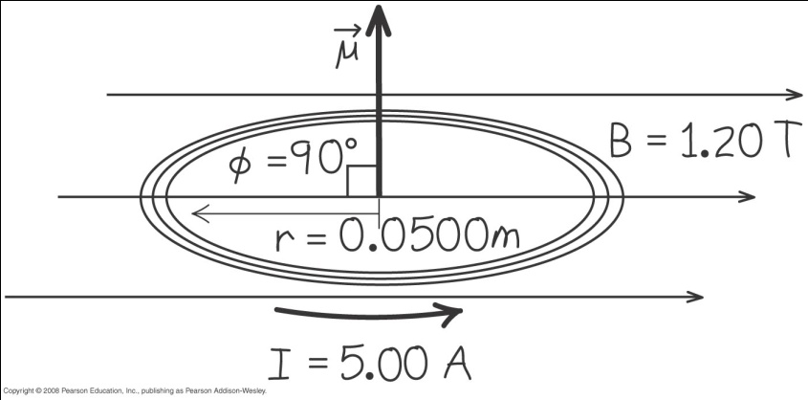
Example 6
A circular coil 0.0500 m in radius, with 30 turns of wire, lies in a horizontal plane. It carries a current of 5.00 A in a counter-clockwise sense when viewed from above. The coil is in a uniform field directed towards the right, with magnitude 1.20 T. Find the magnitudes of the magnetic moment and the torque on the coil.

Slide 26
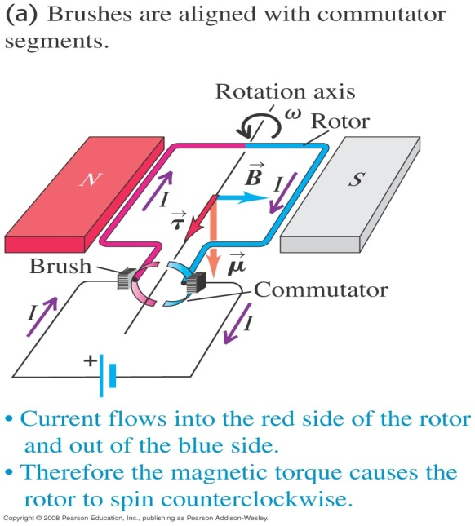
The Direct-Current motor
The rotor is an open-ended loop of wire and free to rotate about an axis.
The ends of the wire are attached to elements that form a commutator.
Each commutator segment makes contact with one of the brushes of an external circuit that includes a source of emf.
Hence the rotor is a current loop with a magnetic moment.
The magnetic field exerts a torque on the rotor and causes the rotor to rotate counter clockwise so that B is aligned with µ.

Slide 27
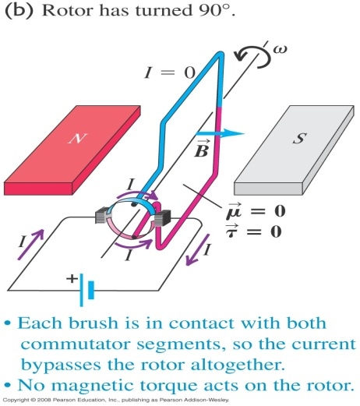
The Direct-Current motor
When B is aligned with µ, there is no potential difference between the segments of the commutator.
At this instant no current flows through the rotor and the magnetic moment is zero.
The rotor continues to rotate counter clockwise because of its inertia until current flows again through the rotor.
Notes:
The figure shows the rotor rotated by 90º.

Slide 28
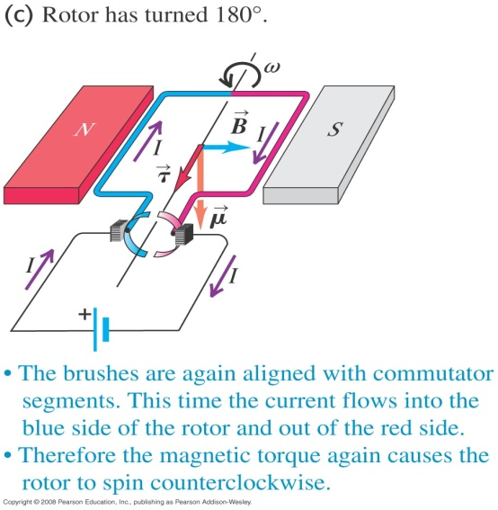
The Direct-Current motor
The rotor has now rotated 180º and µ is in the same direction with respect to B. The torque is in the same direction as before.
Due to the commutator, the current reverses after every 180º of rotation so the torque is always in the direction to rotate the rotor counter clockwise.

Slide 29
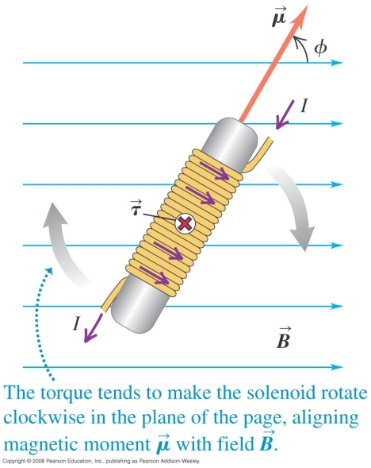
Solenoid
A solenoid consists of a number of circular loops lying in planes at right angles to its axis.
For a solenoid with N turns, the magnetic moment is μ = NiA. The torque is and it rotates the solenoid until its axis is parallel to the field.

Slide 30
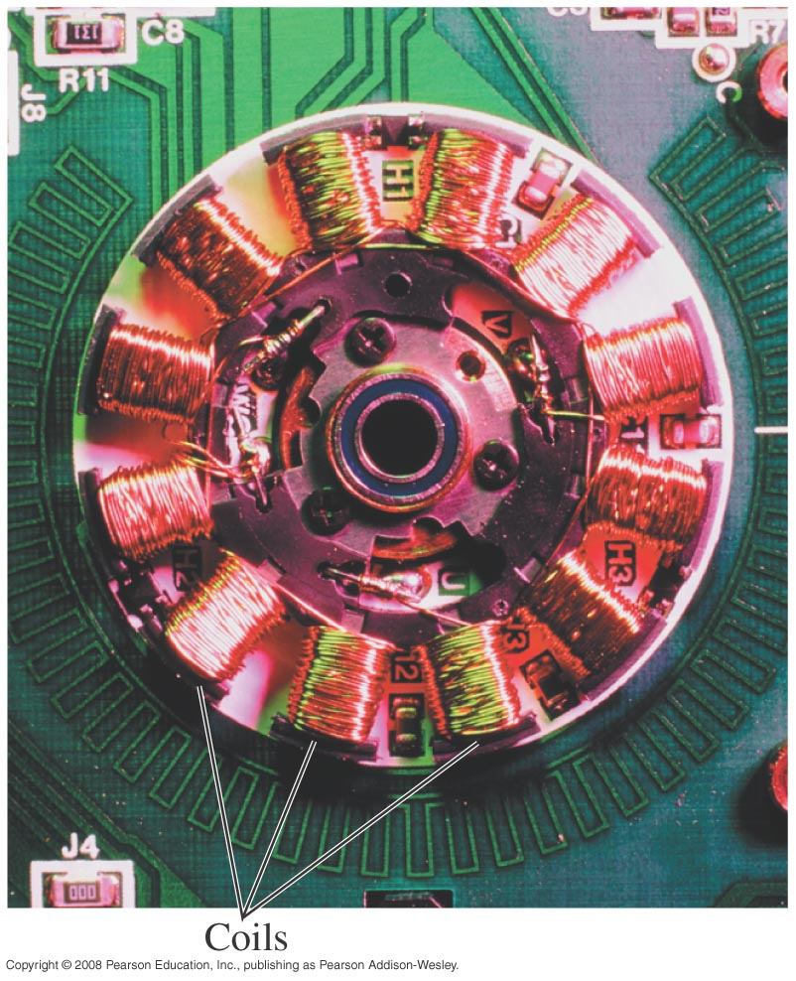
Practical motors
In practical motors, the rotor has many turns.
This increases the magnetic moment and the torque so that the motor can spin larger loads.
The torque can also be increased by using a stronger magnetic field.
Therefore many motors use electromagnets.

Slide 31
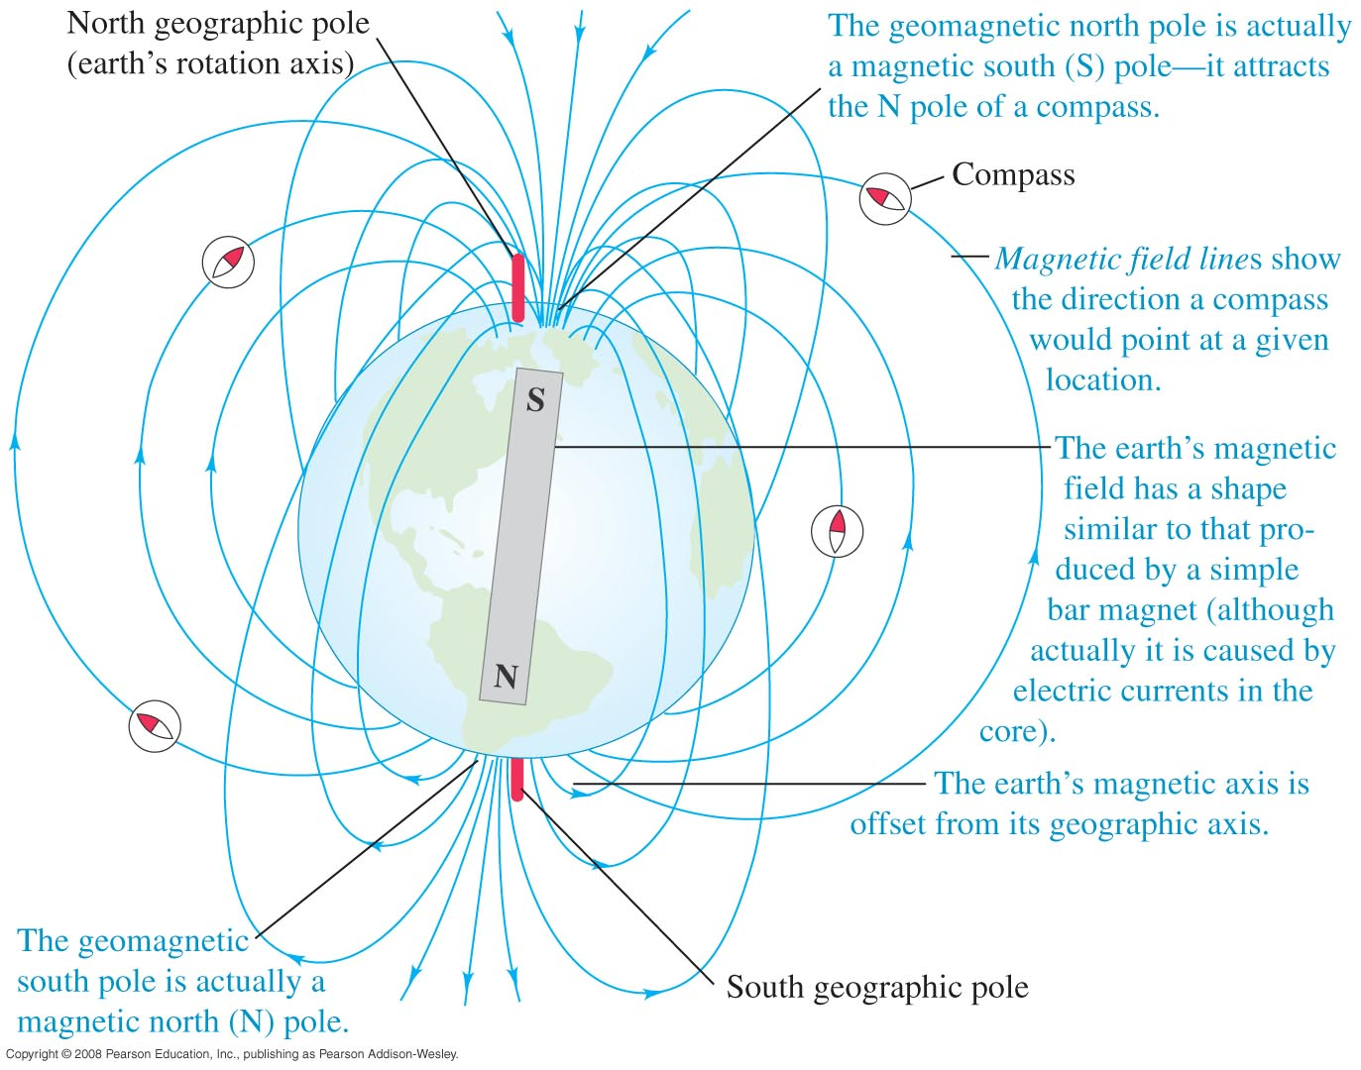
The Earth as a magnet
The Earth is like a magnet with its S pole in the geomagnetic north of the Earth and its N pole in the geomagnetic south of the Earth.
The Earth magnetic axis is not aligned with its geographic axis. Hence its geomagnetic poles are not at the same place as its geographic poles.
This leads to magnetic compass errors known as magnetic variation.

Slide 32
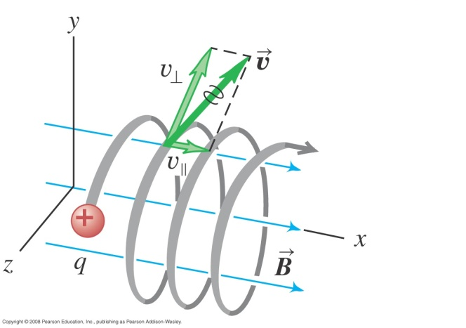
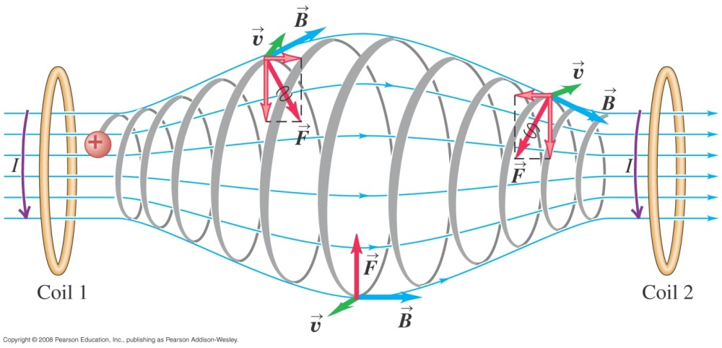
Charge particle not perpendicular to magnetic field
If the particle’s initial velocity is not perpendicular to the field, it will move in a helix with the radius we derived earlier.
If the field is not uniform, the particles will move to and fro within the field.

Slide 33
End of chapter

